Slide 1
Overview
Relation
Properties of Relation
Correspondence of terms with E-R Model
Keys
Integrity Constraints
Mapping Regular Entity into Relation

Slide 2
Relation
Definition: A relation is a named, two-dimensional table of data
Table consists of rows (records) and columns (attribute or field)
Requirements for a table to qualify as a relation:
It must have a unique name
Every attribute value must be atomic (not multivalued, not composite)
Every row must be unique (can’t have two rows with exactly the same values for all their fields)
Attributes (columns) in tables must have unique names
The order of the columns must be irrelevant
The order of the rows must be irrelevant
NOTE: all relations are in 1st Normal form

Slide 3
Mathematical Relation
The order of columns in mathematical relations does matter, whereas in database relations it does
not matter.
A math relation is a Cartesian product
of two sets.
So if we change the order of these two sets then the outcome of both will not be same.

Slide 4
Mathematical Relation
Therefore, the math relation changes by
changing the order of columns.
For Example , if there is a set A and a set B if we take Cartesian product of A and B
then we take Cartesian product of
B and A they will not be equal

Slide 5
Correspondence with E-R Model
Relations (tables) correspond with entity types and with many-to-many relationship types
Rows correspond with entity instances and with many-to-many relationship instances
Columns correspond with attributes
The word relation (in relational database) is NOT the same as the word relationship (in E-R model)

Slide 6
Key Fields
Keys are special fields that serve two main purposes:
Primary key :
An attribute or a combination of attributes that uniquely identifies each row in a relation.
is a unique identifier of the relation
Examples include employee numbers, social
security numbers, etc.
Foreign key :
An attribute in a relation that serves as the primary key of another relation in the same database.
Enable a dependent relation (on the many side of a relationship) to refer to its parent relation (on the one side of the relationship)

Slide 7
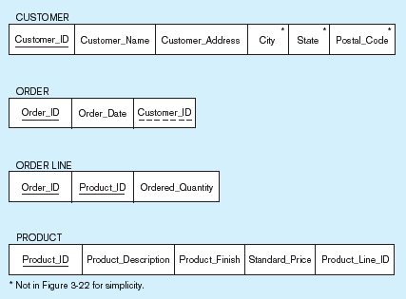
Figure 5-3 Schema for four relations (Pine Valley Furniture Company)
Primary Key
Foreign Key (implements 1:N relationship between customer and order)
Combined, these are a composite primary key (uniquely identifies the order line)…
Individually they are foreign keys (implement M:N relationship between order and product)

Slide 8
Integrity Constraints
Domain Constraints
Allowable values for an attribute.
Entity Integrity
No primary key attribute may be null. All
primary key fields MUST have data.
Action Assertions
Business rules.

Slide 9
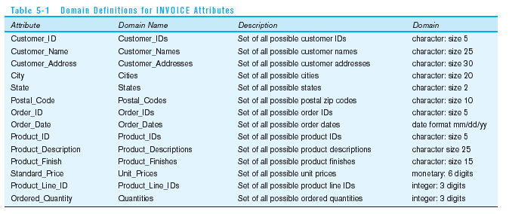
Domain definitions enforce domain integrity constraints

Slide 10
Integrity Constraints
Referential Integrity: A rule that states that either each
foreign key value must match a primary key value in another relation Or the foreign key value must be null.
For example: Delete Rules
Restrict – don’t allow delete of “parent” side if related rows exist in “dependent” side
Cascade – automatically delete “dependent” side rows that correspond with the “parent” side row to be deleted
Set-to-Null – set the foreign key in the dependent side to null if deleting from the parent side → not allowed for weak entities

Slide 11
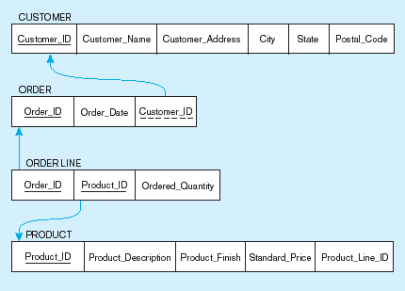
Figure 5-5
Referential integrity constraints (Pine Valley Furniture)
Referential integrity constraints are drawn via arrows from dependent to parent table

Slide 12
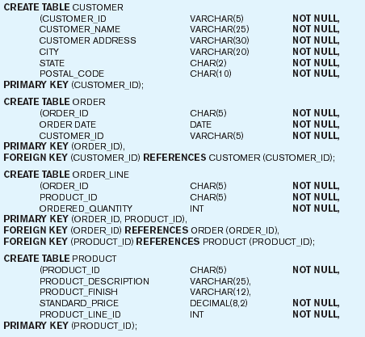
Figure 5-6 SQL table definitions
Referential integrity constraints are implemented with foreign key to primary key references

Slide 13
Thanks

